Slide 1
Pseudo Char Device Driver
Prepared by: Mostafa Tera

Slide 2
Types of Device Drivers
Built-in Drivers
Drivers compiled directly into the kernel.
Loadable Modules
Drivers compiled as separate files that can be dynamically loaded and unloaded.

Slide 3
What is the Build System
Definition:
- A system of tools and scripts used to compile the kernel and its modules.
Key Components:
- Makefiles:
Define how the kernel and modules are built.
- Build Scripts:
Automate the compilation process, managing dependencies and configurations.
Location:
- Its located under /usr/src/linux-headers-$(uname -r)
Note: if its not there it can be downloaded using ‘ sudo apt install linux-headers-$(uname -r)’

Slide 4
How to create and compile your driver?
1- Write your driver source code:
- Example: mymodule.c
2- Write Makefile for your Driver
- This Makefile specify how you want the build system to compile your driver ( Built-in or Loadable)
- The Makefile should include:
obj-y += mymodule.o for Built-in Driver
obj-m += mymodule.o for Loadable Driver
3- Invoke the build system to build your driver by parsing your Makefile
- invoke by using ‘ make M=/path/to/directory modules ‘ command

Slide 5
Char device ID [ Major + Minor ]
12 bits
20 bits
- Each Device in the system has an ID of 32 bits
Major number
Minor number
- This ID is stored in the kernel data base in 32 bit variable of type dev_t
- Major number:
Identifies the driver responsible for that device.
- Minor number:
Identifies the number of that device.

Slide 6
USER SPACE
Application
echo 1 > /dev/file
system call
Major = 30
Minor = 1
KERNEL SPACE
VFS
Major = 30
Major = 50
Driver1
driver1_write(int minor );
Driver2
driver2_write(int minor );
Minor = 0
Minor = 1
Minor = 2
Minor = 0
Minor = 1
Device1
Device2
Device3
Device4
Device5

Slide 7
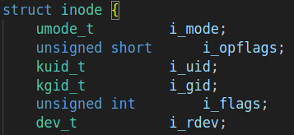
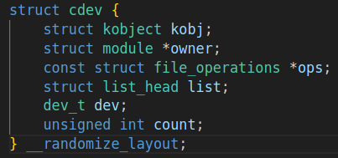
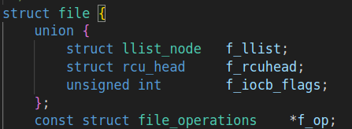
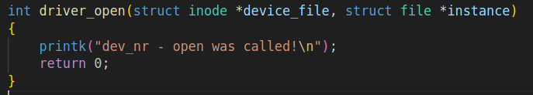
USER SPACE
Application
open ( "/dev/tty " , O_RDWR )
System Call
Major and Minor
KERNEL SPACE
Virtual File System (VFS)
Use Major Number to
find the Device Driver
VFS Looks up inode for /dev/tty
Device Driver
Device Driver
VFS creates file struct
with the file_operations

